Slide 1
S1.02 : Comparaison d’approches algorithmiques
Anthony Hascoet & Clément MONFORT

Slide 2
Methode | n | Ɵ | cpt / Ɵ | Lim n → ∞ f(n) / Ɵ | Temps (nanosecondes)
PGS1 | 4000 | Ɵ(n3) | 0,16 | n3 / n3 = 0,16 | 6248783800
 | 8000 |  |  |  | 42793249700
PGS2 | 64000 | Ɵ(n2) | 0.5 | n2 / n2 = 0.5 | 44110100
 | 128000 |  |  |  | 4148871900
PGS3 | 1024000 | Ɵ(nlog2n) | 0.8 | nlog2n / nlog2n = 08 | 40960800
 | 2048000 |  |  |  | 134761100
PGS4 | 1024000 | Ɵ(n) | 1 | n / n = 1 | 1048700
 | 2048000 |  |  |  | 1752400

Slide 3
Plus Grde Somme 1
int[] sum = (tab == null) ? null : new int[] { 0, 0, 0 };
if (sum != null && !TabIsNeg(tab)) {
sum[0] = tab[0];
for (int i = 0; i < tab.length; i++) {
for (int j = i; j < tab.length; j++) {
findGreatestSumInterval(tab, sum, i, j);
}
}
} else if (tab == null) {
System.err.println("Error: The integer array is null.");
}
return (sum);

Slide 4
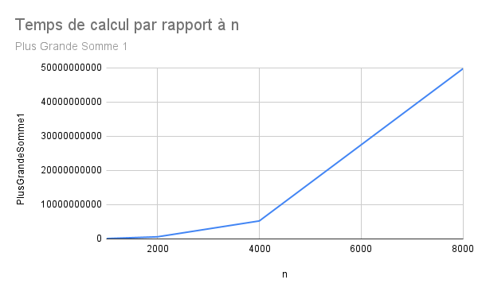
Plus Grande Sommes 1

Slide 5
Plus Grande Somme 2
int[] sum = (tab == null) ? null : new int[] { 0, 0, 0 };
int buf = 0;
if (sum != null && !TabIsNeg(tab)) {
sum[0] = tab[0];
for (int i = 0; i < tab.length; i++) {
buf = 0;
for (int j = i; j < tab.length; j++) {
buf += tab[j];
if (buf > sum[0]) {
sum[0] = buf;
sum[1] = i;
sum[2] = j;
}
cpt++;
}
}
} else {
System.err.println("Error: The integer array is null.");
}
return (sum);
}

Slide 6
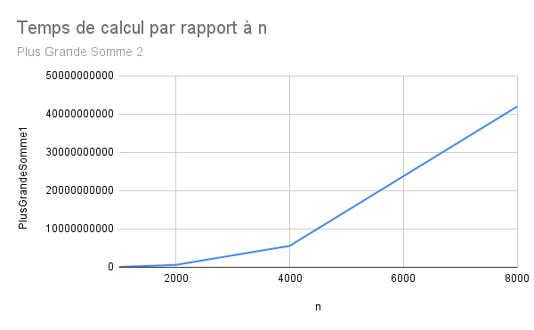
Plus Grande Sommes 2

Slide 7
Plus Grande Somme 3
int mid = (deb + end) / 2;
int[] sum = (tab == null) ? null : new int[] { 0, 0, 0 };
int[] sum1 = null;
int[] sum2 = null;
int max = 0;
int buf = 0;
if (sum != null && end < tab.length && deb >= 0 && deb <= end
&& !TabIsNeg(tab)) {
//Condition de fin de l’appelle récursif.
if (deb == end) {
sum[0] = tab[end];
sum[1] = deb;
sum[2] = end;
} else {
sum[1] = mid;
sum[2] = mid + 1;
//Calcule de la plus grande somme à chevale.
if (sum1[0] >= sum2[0] && sum1[0] >= sum[0]) {
sum = sum1;
} else if (sum2[0] >= sum1[0] && sum2[0] >= sum[0]) {
sum = sum2;
}
}
}
return (sum);
}
//Calcule de la plus grande somme à chevale, partie Gauche.
sum1 = plusGrdeSomme3(tab, deb, mid);
buf = tab[mid];
max = tab[mid];
for (int i = mid - 1; i >= deb; i--) {
buf += tab[i];
if (buf > max) {
max = buf;
sum[1] = i;
}
cpt++;
}
sum[0] += max;
//Calcule de la plus grande somme à chevale, partie Droite.
sum2 = plusGrdeSomme3(tab, mid + 1, end);
buf = tab[mid + 1];
max = tab[mid + 1];
for (int i = mid + 2; i <= end; i++) {
buf += tab[i];
if (buf > max) {
max = buf;
sum[2] = i;
}
cpt++;
}
sum[0] += max;

Slide 8
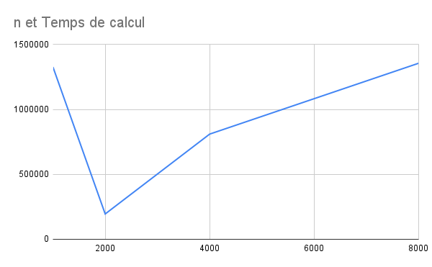
Plus Grande Sommes 3

Slide 9
Plus Grande Somme 4
int[] sum = (tab == null) ? null : new int[] { 0, 0, 0 };
int buf = 0;
int deb = 0;
if (sum != null && !TabIsNeg(tab)) {
sum[0] = tab[0];
for (int i = 0; i < tab.length; i++) {
buf += tab[i];
if (buf > sum[0]) {
sum[0] = buf;
sum[1] = deb;
sum[2] = i;
}
if (buf < 0) {
deb = i + 1;
buf = 0;
}
cpt++;
}
} else {
System.err.println("Error: The integer array is null.");
}
return (sum);

Slide 10
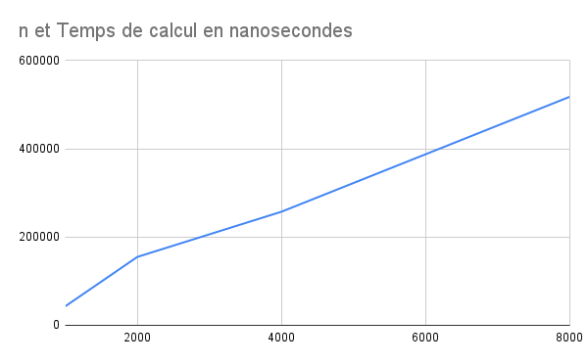
Plus Grande Sommes 4

